Slide 1



What is TensorFlow?
Notes:
Style - 01

Slide 2
Agenda
What is Deep Learning?
Top Deep Learning Libraries
Why TensorFlow?
What is TensorFlow?
What are Tensors?
What is a Data Flow Graph?
Program Elements in TensorFlow
Use case implementation using TensorFlow
Notes:
Style - 01

Slide 3
What is Deep Learning?
Deep Learning is a subset of Machine Learning and it works on the structure and functions of a human brain. It learns from data that is unstructured and uses complex algorithms to train a neural net.
Input Layer
Hidden Layers
Output Layer
Notes:
Style - 01

Slide 4
What is Deep Learning?
Deep Learning is a subset of Machine Learning and it works on the structure and functions of a human brain. It learns from data that is unstructured and uses complex algorithms to train a neural net.
Accepts large volumes of data as input to build the network
Input Layer
Hidden Layers
Output Layer
Notes:
Style - 01

Slide 5
What is Deep Learning?
Deep Learning is a subset of Machine Learning and it works on the structure and functions of a human brain. It learns from data that is unstructured and uses complex algorithms to train a neural net.
Processes the data by performing complex operations and carries out feature extraction
Input Layer
Hidden Layers
Output Layer
Notes:
Style - 01

Slide 6
What is Deep Learning?
Deep Learning is a subset of Machine Learning and it works on the structure and functions of a human brain. It learns from data that is unstructured and uses complex algorithms to train a neural net.
Generate the predicted output by applying suitable activation functions
Input Layer
Hidden Layers
Output Layer
Notes:
Style - 01

Slide 7





Top Deep Learning Libraries
Developed by Francois Chollet
Open source library written in Python
Developed by University of Montreal
Written in Python
Developed by Google Brain Team
Written in C++, Python and CUDA
1
2
3
4
5
Developed by Skymind engineering team and DeepLearning4J community
Written in C++ and Java
Created by Ronan Collobert, Koray kavukcuoglu, Clement Farabet
Written in Python
Notes:
Style - 01

Slide 8


Why TensorFlow?
Provides both C++ and Python API’s that makes it easier to work on
Notes:
Style - 01

Slide 9
Why TensorFlow?
Provides both C++ and Python API’s that makes it easier to work on
Has a faster compilation time than other Deep Learning libraries like keras and torch
Notes:
Style - 01

Slide 10
Why TensorFlow?
Provides both C++ and Python API’s that makes it easier to work on
Has a faster compilation time than other Deep Learning libraries like keras and torch
TensorFlow supports both CPU’s and GPU’s computing devices
Notes:
Style - 01

Slide 11


What is TensorFlow?
Open source library developed by Google
Developed originally to run large numerical computations
2
5
Accepts data in the form of multidimensional arrays of higher dimensions called Tensors
7
Edges
8
1
Works on the basis of Data Flow graphs that have nodes and edges
Nodes
Notes:
Style - 01

Slide 12
What is TensorFlow?
Open source library developed by Google
Developed originally to run large numerical computations
2
5
Accepts data in the form of multidimensional arrays of higher dimensions called Tensors
7
Edges
8
1
Works on the basis of Data Flow graphs that have nodes and edges
Nodes
Notes:
Style - 01

Slide 13
What is TensorFlow?
Open source library developed by Google
Developed originally to run large numerical computations
2
5
Accepts data in the form of multidimensional arrays of higher dimensions called Tensors
7
Edges
8
1
Works on the basis of Data Flow graphs that have nodes and edges
Nodes
Notes:
Style - 01

Slide 14
What is TensorFlow?
Open source library developed by Google
Developed originally to run large numerical computations
2
5
Accepts data in the form of multidimensional arrays of higher dimensions called Tensors
7
Edges
8
1
Works on the basis of Data Flow graphs that have nodes and edges
Nodes
Notes:
Style - 01

Slide 15

What are Tensors?
Tensors
Tensor is a generalization of vectors and matrices of potentially higher dimensions. Arrays of data with different dimensions and ranks that are fed as input to the neural network are called Tensors.
3
5
4
2
6
7
Data in the form of arrays is fed as input to the network
8
1
3
2
5
9
1
4
2
Input Layer
Hidden Layers
Output Layer
Notes:
Style - 01

Slide 16
What are Tensors?
Tensors
Tensor is a generalization of vectors and matrices of potentially higher dimensions. Arrays of data with different dimensions and ranks that are fed as input to the neural network are called Tensors.
a
d
Different Dimensions
k
Tensor of Dimensions[5]
m
q
Notes:
Style - 01

Slide 17
What are Tensors?
Tensors
Tensor is a generalization of vectors and matrices of potentially higher dimensions. Arrays of data with different dimensions and ranks that are fed as input to the neural network are called Tensors.
1
3
4
7
9
7
3
2
Different Dimensions
8
4
1
6
Tensor of Dimensions[5,4]
6
3
9
1
3
1
5
9
Notes:
Style - 01

Slide 18

What are Tensors?
Tensors
Tensor is a generalization of vectors and matrices of potentially higher dimensions. Arrays of data with different dimensions and ranks that are fed as input to the neural network are called Tensors.
Different Dimensions
Tensor of Dimensions[3,3,3]
Notes:
Style - 01

Slide 19
Tensor Ranks
Tensor of Rank 0
Tensor of Rank 1
s= [200]
v=[10,11,12]
Tensor of Rank 3
Tensor of Rank 2
t=[[[1],[2],[3]],[[4],[5],[6]],[[7],[8],[9]]]
m=V=[1,2,3],[4,5,6]
Notes:
Style - 01

Slide 20

What is a Data Flow graph?
Each computation in TensorFlow is represented as a Data Flow Graph
Each node in the graph represents a mathematical operation (add, subtract, multiply, etc) and each edge represents multidimensional arrays (Tensors)
Computational Graph is the graph of programming logic which Tensorflow builds in the memory
Enables creating large scale neural networks as computing can be distributed across several CPU’s or GPU’s
Source: TensorFlow website
Notes:
Style - 01

Slide 21

Program Elements in TensorFlow
Building a computational graph
Step 1
TensorFlow programs work on two basic concept
Executing a computational graph
Step 2
Notes:
Style - 01

Slide 22
Program Elements in TensorFlow
Constants
Constants are parameters whose value does not change. To define a constant we use tf.constant() command.
Example:
a = tf.constant(2.0, tf.float32)
b = tf.constant(3.0)
Print(a, b)
Notes:
Style - 01

Slide 23
Program Elements in TensorFlow
Placeholder
Placeholders allow us to feed data to a tensorflow model from outside a model. It permits a value to be assigned later. To define a placeholder we use tf.placeholder() command.
Example:
a = tf.placeholder(tf.float32)
b = a*2
with tf.Session() as sess:
result = sess.run(b,feed_dict={a:3.0})
print result
feed_dict specifies tensors that provide concrete values to the placeholders
Notes:
Style - 01

Slide 24
Program Elements in TensorFlow
Variable
Variables allow us to add new trainable parameters to graph. To define a variable we use tf.Variable() command and initialize them before running the graph in a session.
Example:
W = tf.Variable([.3],dtype=tf.float32)
b = tf.Variable([-.3],dtype=tf.float32)
x = tf.Placeholder(tf.float32)
linear_model = W*x+b
Notes:
Style - 01

Slide 25
Program Elements in TensorFlow
Session
A session is run to evaluate the nodes. This is called as the TensorFlow runtime.
Example:
a = tf.constant(5.0)
b = tf.constant(3.0)
c = a*b
# Launch Session
sess = tf.Session()
# Evaluate the tensor c
print(sess.run(c))
5.0
Multiplication
15.0
3.0
Running a Computation Graph
Notes:
Style - 01

Slide 26
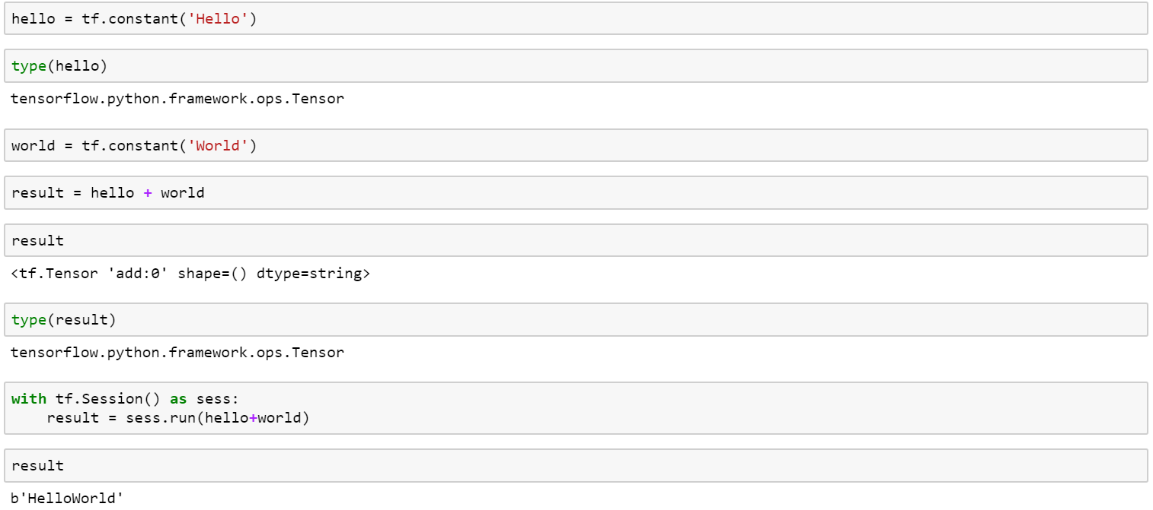
TensorFlow program basics
HelloWorld using TensorFlow
Notes:
Style - 01

Slide 27
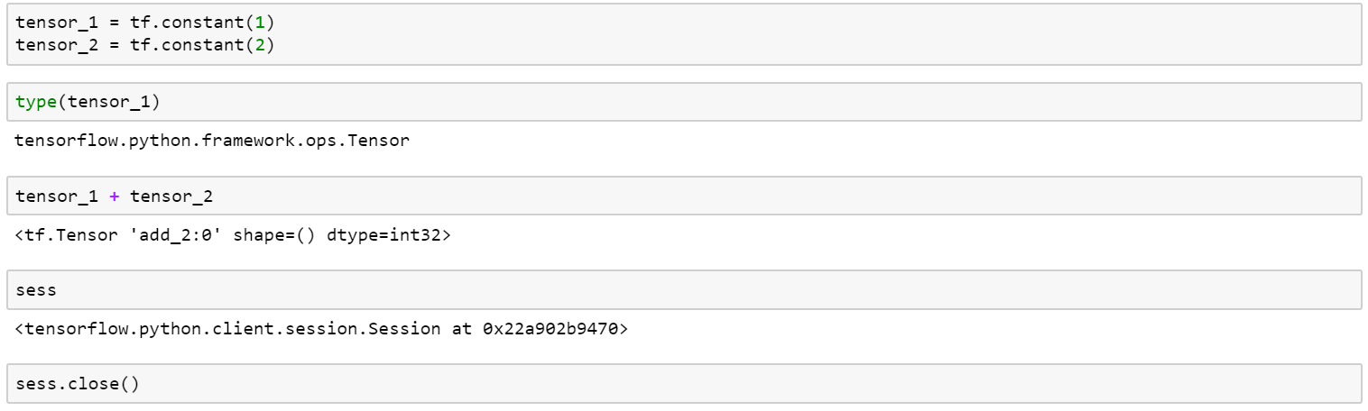
TensorFlow program basics
Performing Computations using TensorFlow
Notes:
Style - 01

Slide 28
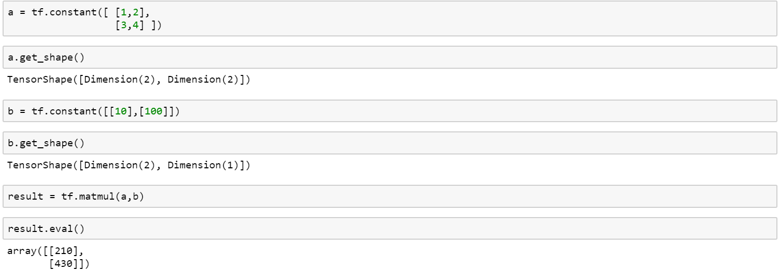
TensorFlow program basics
Matrix Multiplication using TensorFlow
Notes:
Style - 01

Slide 29
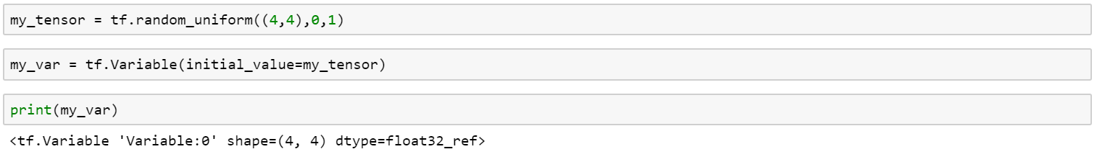
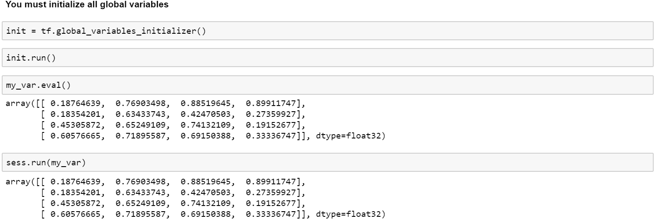
TensorFlow program basics
Variables in TensorFlow
Notes:
Style - 01

Slide 30
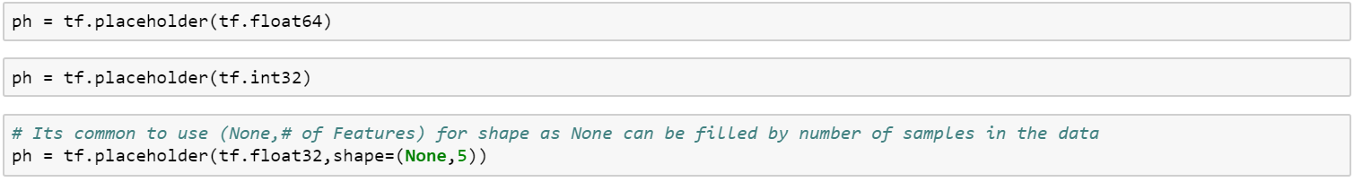
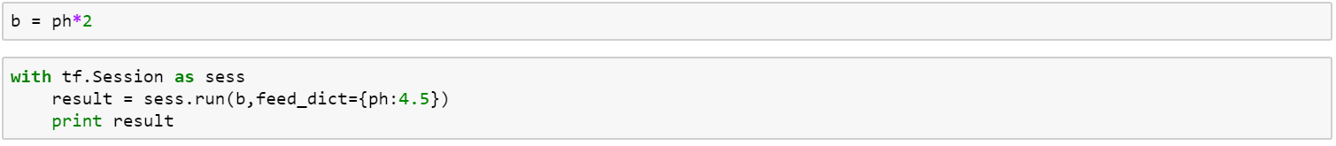
TensorFlow program basics
Placeholders in TensorFlow
Notes:
Style - 01

Slide 31
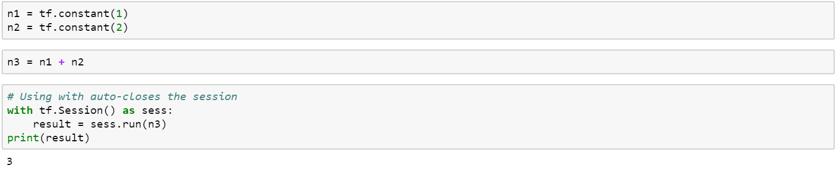
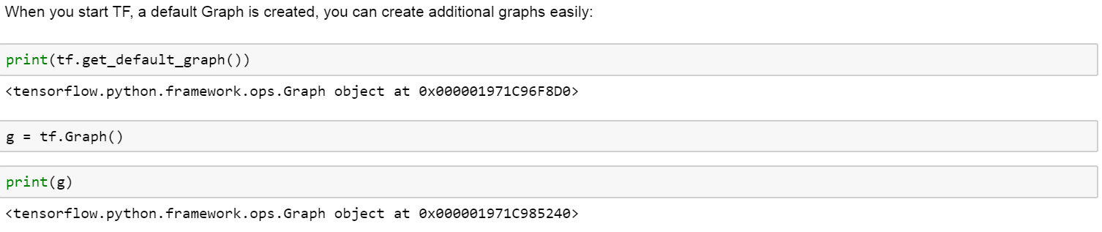
TensorFlow program basics
TensorFlow Graphs
Notes:
Style - 01

Slide 32


Use case Implementation using TensorFlow
Lets use various features of an individual to predict what class of income they belong to (>50k or <=50k) using a Census Data.
age
martial_status
gender
native_country
workclass
occupation
capital_gain
income_bracket
education
relationship
capital_loss
Predict Income
education_num
race
hours_per_week
Notes:
Style - 01

Slide 33
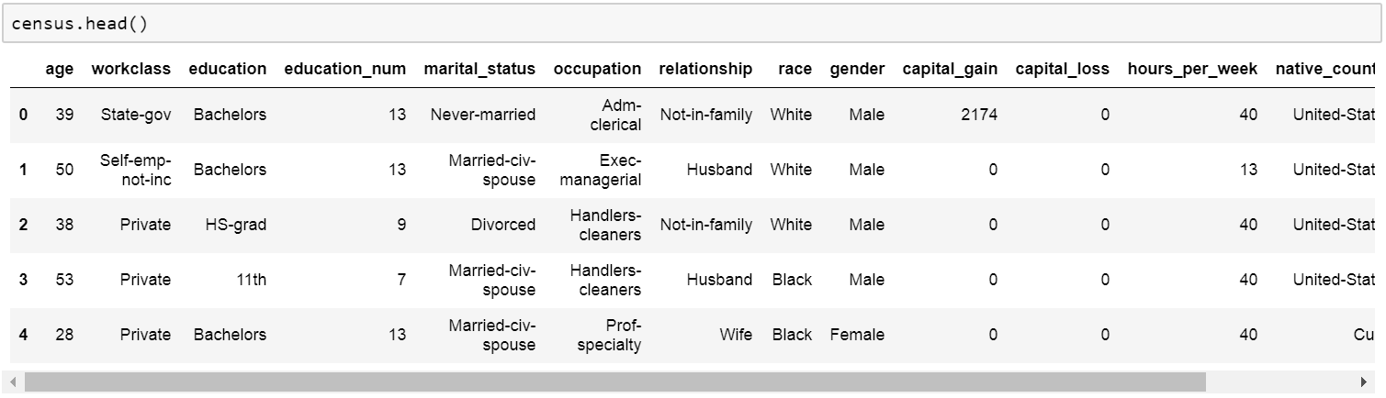
Use case Implementation using TensorFlow
1. Read the census_data.csv using pandas library
2. Display the head of the dataset
Notes:
Style - 01

Slide 34
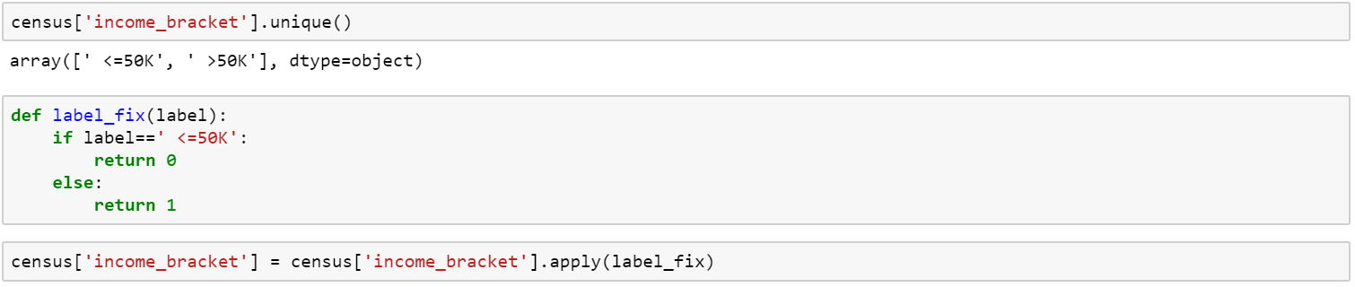
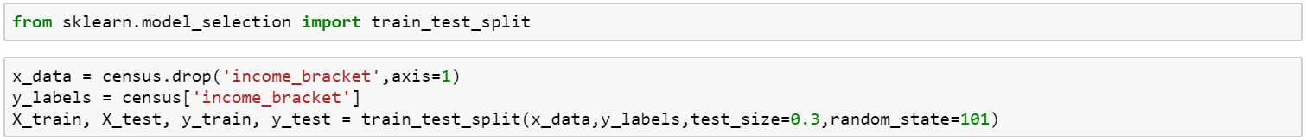
Use case Implementation using TensorFlow
3. Convert the Label column to 0s and 1s instead of strings
4. Perform a Train Test split on the data
Notes:
Style - 01

Slide 35
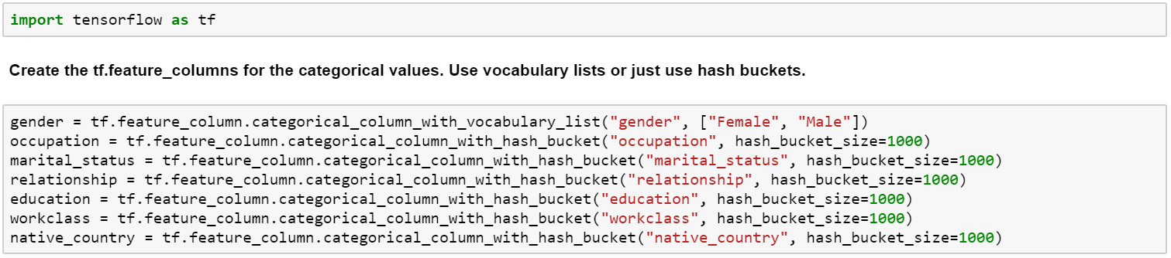
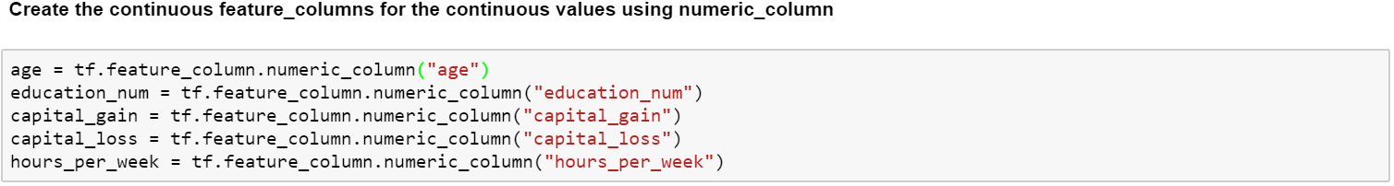
Use case Implementation using TensorFlow
5. Create the feature columns for the categorical values using vocabulary lists or hash buckets
6. Create the feature columns for the continuous values using numeric_column
Notes:
Style - 01

Slide 36
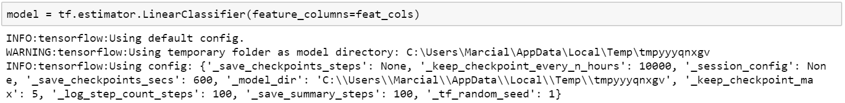
Use case Implementation using TensorFlow
7. Put all these variables into a single list with the variable name feat_cols
8. Create the input function. Batch size it up to you
9. Create the Model with tf.estimator using LinearClassifier
Notes:
Style - 01

Slide 37
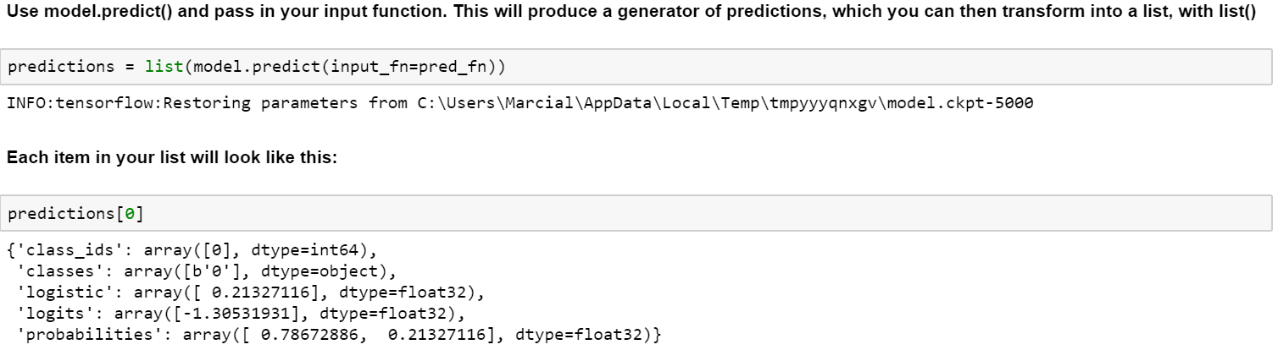
Use case Implementation using TensorFlow
10. Train the model for at least 5000 steps
11. Evaluation of the model
Notes:
Style - 01

Slide 38
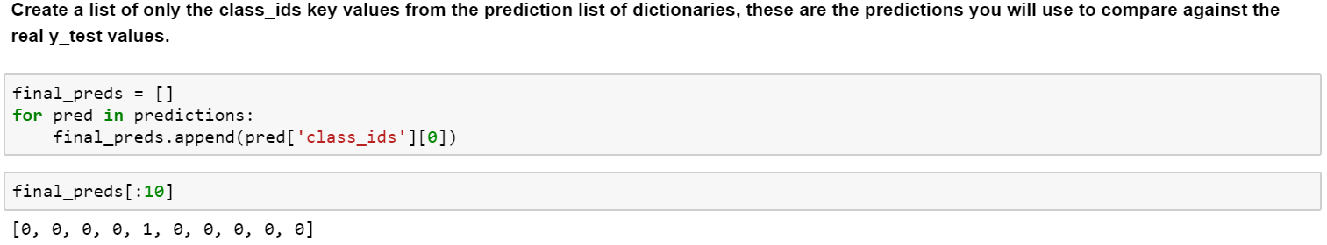
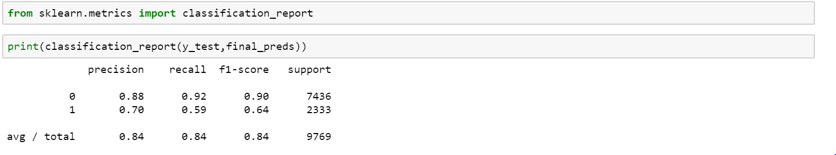
Use case Implementation using TensorFlow
12. Create a list of class_ids key values from the prediction list of dictionaries. These predictions will be used to compare against y_test values
13. Calculate models performance on Test data
Notes:
Style - 01

